Slide 1
Geospatial assessment of urban farming potential in metropolitan areas (NYC)
AR Presentation

Slide 2
Agenda
Introduction and motivation
High Level Architecture of the Software
Running Platform
Input data type
Training data
Overview of individual processing steps
Supervised learning
NDVI
Outputs
Outputs examples
GUI Developments
Validation and verification
Milestones Progress
Future steps
Requirements check
DEM
Multispectral classification

Slide 3
Why to choose urban farming
A vital topic referring to the exploding population nowadays.
Providing a multiple and flexible way in food supply system.
Exploring the solution of insufficient cultivated land per capita.
Reducing carbon footprint and food miles.
Decreasing the pressure of Environment.

Slide 4
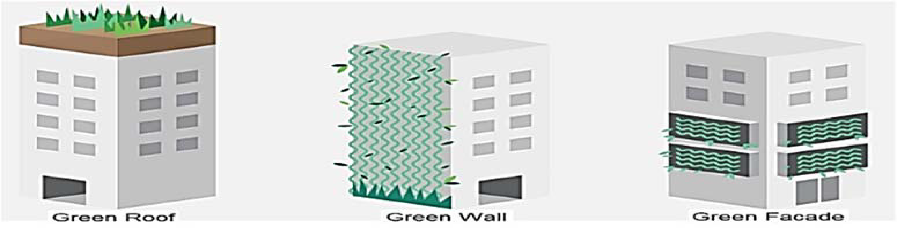
Orientations for urban farming
Abandoned urban land
Vertical building
Pre-Urban area
For some technical reasons(The expends of Green wall and façade are relatively high), we mainly research on the methods 1, 3, and flat rooftops.

Slide 5
Project scope and main idea
To ease the pressure of urban food security and exploit the largest land cover in metropolitan cities (buildings), team 1 has dedicated its efforts to create a dynamic map of potential rooftops and vacant lands that are suitable for urban farming.
Primary Objective​
Analyze Sentinel-2 and DSM data to determine potential rooftops and ground areas that are suitable for urban farming according to a specified criteria.​
​
Secondary Objective​
Approximate and validate the crops yield from urban farming. Analyze other factors such as sun exposure, soil and air quality, etc.​

Slide 6
Mission Objective
The outcome of the geospatial assessment of urban farming (UF) potential in metropolitan areas will be digital maps indicating potential rooftops and vacant lands in metropolitan areas. The generation system of the UF potential map shall be generalized to be applied to all metropolitan areas with adequate resolution geospatial data provided. For a detailed look into the system requirements, please refer to SRD.

Slide 7
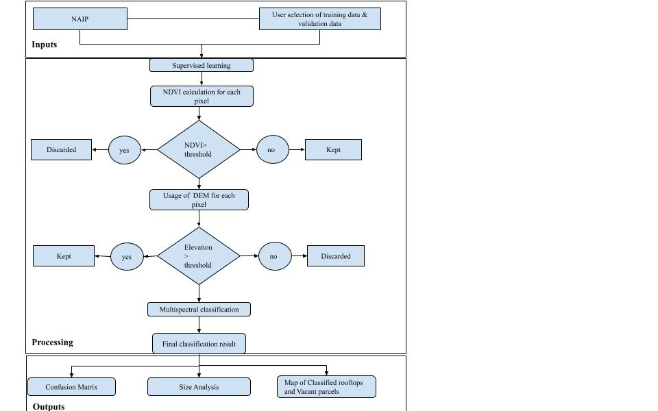
High Level Architecture of the Software

Slide 8


Running platform
Google Earth Engine GEE as the main testing and compiling platform
Jupyter notebook, because it uses python script, unlike GEE which supports Javascript

Slide 9
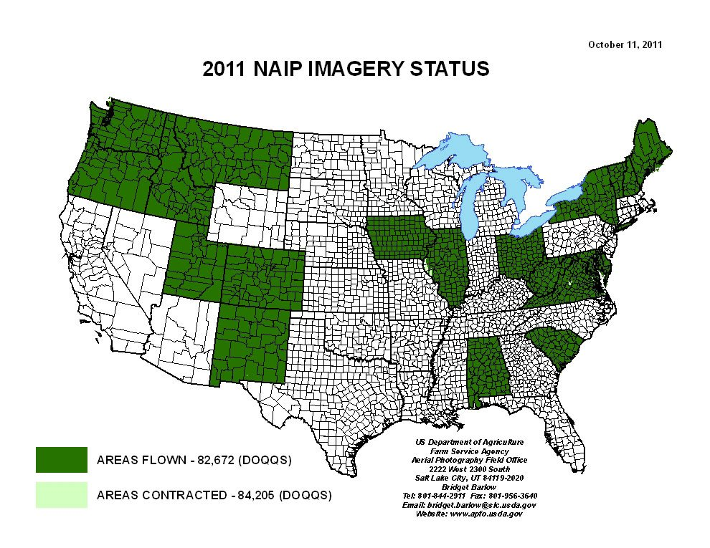
Input data
Our input source is NAIP (National Agriculture Imagery Program)
Aerial images acquired of the USA during agriculture growing season
Provides resolution of 1m.
DEM of the respective location to eliminate ground pixels, based on elevation input. NED- National elevation Dataset by UGSC(United States Geological Survey)
Photo credit: USDA Farm Service Agency

Slide 10
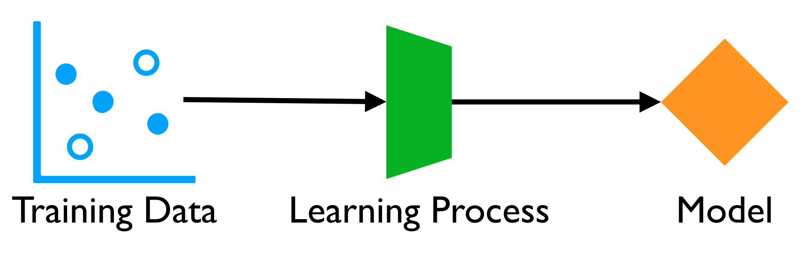
Input training and validation data
~ 60 input training data areas are required to run the classifier. However, it is recommended to include more polygons in a spread out manner to enhance output accuracy
Resolution of training input is the same as NAIP resolution
Validation data are for the calculation of confusion matrix

Slide 11
Overview of individual processing steps
Supervised Learning
Discarding vegetation pixels in the classification.
Discarding ground object pixels in the classification.
Multispectral classification

Slide 12
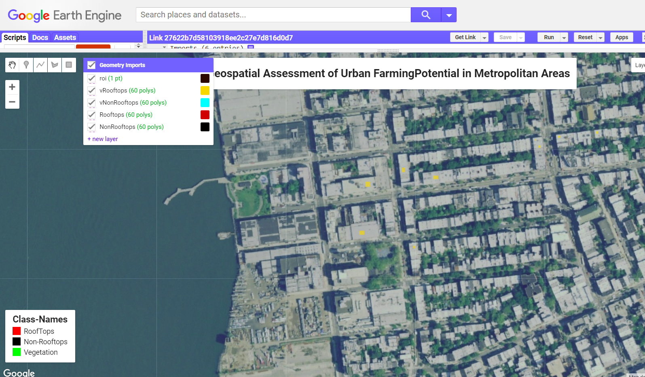
Supervised learning
User selecting few areas of each class (min. of 20-30).
This data is used to train the classifier in one particular location.

Slide 13
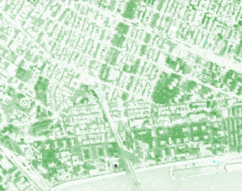
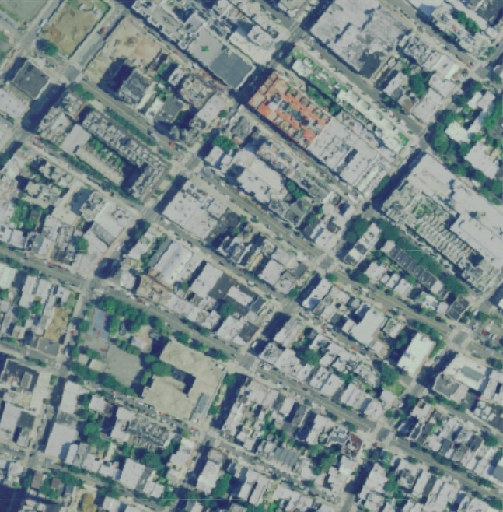
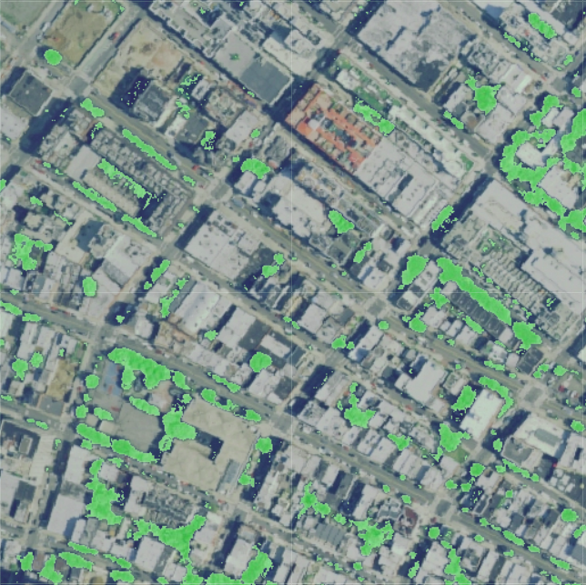
Discarding vegetation pixels
NDVI = (NIR-RED)/(NIR+RED)
Input Imagery
True color masked image after NDVI

Slide 14
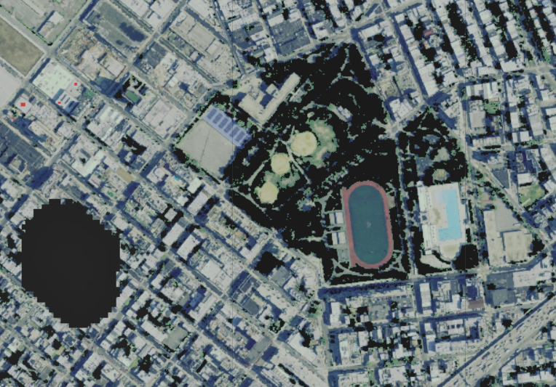
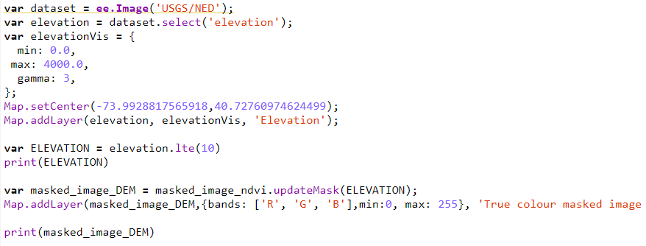
Discarding ground object pixels
True color masked image after DEM
DEM integration into GEE

Slide 15
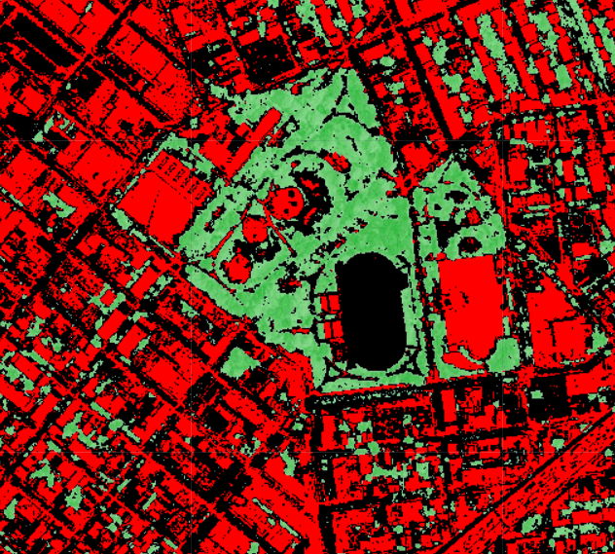
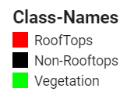
Multispectral classification

Slide 16
Outputs
Output format
Resolution
Confusion matrix.
Size analysis.
Map of classification results.

Slide 17
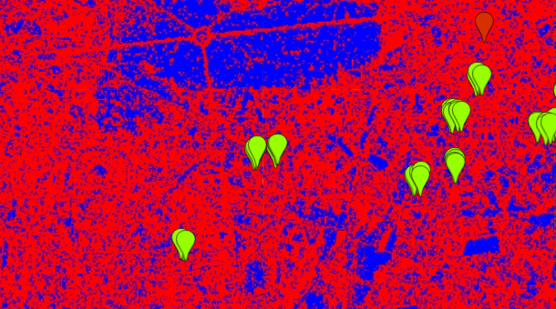
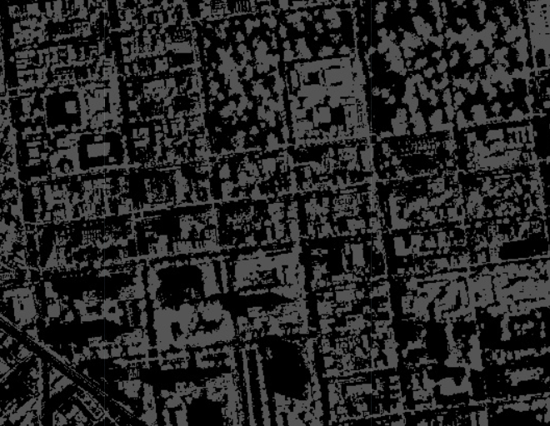
Output examples (First trial)
Classifications are worst due to the input image resolution
Misclassified vegetation pixels
Using Sentinel-2 images. Green: training pixels, Red: Rooftops, Blue: Non-rooftops
Using NAIP imagery: Grey: Rooftops, Black: Non-rooftops

Slide 18
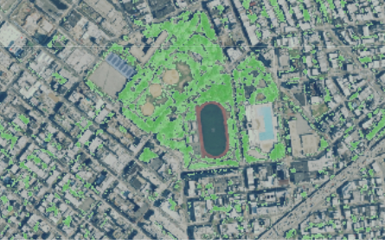
Final trial
Input image masked with NDVI and DEM
After classification

Slide 19
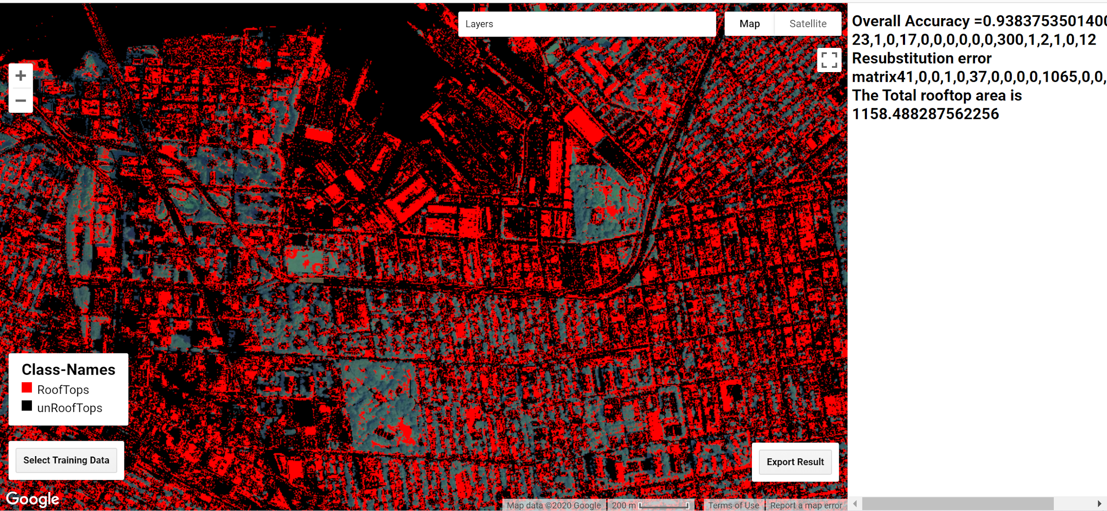
GUI Development
Training Data Selecting Module
Image Selecting Module
Map control Module
Classification Module
Result Display Module
Result Export
Public the website: https://susanshende.users.earthengine.app/view/urban-farm-app
Notes:
Public the website:
https://susanshende.users.earthengine.app/view/urban-farm-app

Slide 20
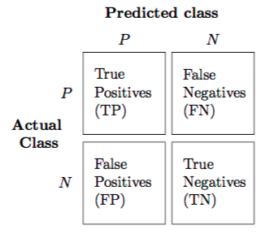
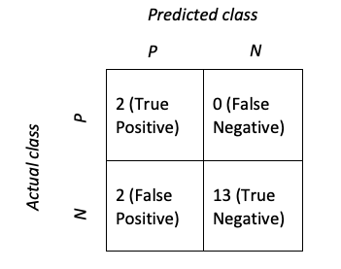
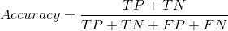
Validation and verification
Confusion matrix
Accuracy limit >80%
= 0.8823

Slide 21
Milestones progress
Input resolution decision
Classifier selection
First test run
NDVI calculation
True color masked layer
DEM to discard ground pixels
Model selection (accuracy)
GUI development
App design
Accuracy assessment

Slide 22
Future steps
Rooftop selection criteria
Morphological operations
Size analysis
Height analysis
Slope analysis
DEM accuracy

Slide 23
Requirements check
# | Requirement | Checked or not
Functional requirements
UFS-PR-FN-01: | The system shall consist of a preprocessing step and a supervised classification algorithm (including PS, SCA). | Checked
UFS-PR-FN-02: | The PS shall involve creating subsets of geospatial data including Sentinel image, GIS data and DSM. | We used DEM instead of DSM
UFS-PR-FN-03: | The SCA shall classify the rooftops and ground area in urban areas in order to generate potential urban farming maps as an output from the input satellite (Sentinel) data as well as higher-level Copernicus products. | Input source was aerial imagery (NAIP) and not Copernicus data

Slide 24
# | Requirement | Checked or not
UFS-PR-FN-04 | The UFS shall include size analysis for the fitness evaluation of potential rooftop and ground area. The UFS should include slope analysis if high resolution and open source DSM’s are available. | This step was postponed to future work
UFS-PR-FN-05 | A graphical user interface (GUI) shall be available to ensure a smooth experience with the final product. The user shall input their desired image data to be processed and give the outcome in an image format as well. | Checked
Performance requirements: Development-Side Performance Requirements
UFS-PR-PF-D1 | SCA shall be trained with around 20-30 pixels and updated per calendar year, including code optimization, algorithm improvement and support of new Sentinel data formats. | We used training pixels and areas. Optimization was performed through NDVI and DEM addition

Slide 25
# | Requirement | Checked or not
UFS-PR-PF-D2 | Classification of urban farming areas shall be extracted with an accuracy of at least higher than 70%. | Checked (accuracy achieved is 88%)
UFS-PR-PF-D3 | The outcome map shall be produced after a maximum of ten minutes from the availability of the input image. | Checked (t < 1 min.)
Performance requirements: User-Side Performance Requirements
UFS-PR-PF-U1 | SCA shall be able to produce maps with legends indicating whether there are rooftops or vacant areas or neither for future crop yield forecast. | Checked (but vacant parcels is a future step)

Slide 26
# | Requirement | Checked or not
Operational Requirements: Infrastructure Requirements:
UFS-PR-OP-I1 | Multispectral and panchromatic images (satellite and/or aerial) shall be analyzed to detect roof tops and vacant parcels. | Checked
UFS-PR-OP-I2 | The desktop used shall be equipped with 3D Graphics Card (updated drives) and a minimum of 4GB RAM in order to use SNAP and ArcGIS. | We did not make use of neither SNAP nor ArcGIS
UFS-PR-OP-I3 | SNAP and ArcGIS softwares shall be accessed through python modules (e.g. snappy and ArcPy) in our code. | We did not make use of SNAP

Slide 27
# | Requirement | Checked or not
Operational requirements: User Execution Environment Requirement:
UFS-PR-OP-U1 | The user shall use Windows, MacOS or Linux with installed Python versions 3.4/3.6 in order to run our code. | Checked
UFS-PR-OP-U2 | The user’s equipment shall satisfy following minimal hardware requirement for smooth ST1 and ST2 operation | Checked (According to aerial imagery available)
Interface requirements:
UFS-PR-IF-01 | The software should accept the input data from the user in raw Sentinel data format (jpg, png or Sentinel images). | Changed to input data that is compatible with GEE

Slide 28
# | Requirement | Checked or not
UFS-PR-IF-02 | The software shall be able to preprocess the maps automatically, without intermediate human intervention | Checked
UFS-PR-IF-03 | The software shall be able to produce the output of pre-process modules, and extract rooftop areas and output the result in image format. | Output is a dynamic map but downloading possibility is not available currently
UFS-PR-IF-04 | The software shall be able to run ArcGIS in order to create overlays of satellite imagery with existing maps such as GIS and/or DSM. | Postponed to future work
UFS-PR-IF-05 | The software shall be able to analyze the suitable area to farm. | Postponed to future work

Slide 29
# | Requirement | Checked or not
UFS-PR-IF-06 | The UFS shall be able to read and write packages of incoming and outgoing files on the computer. | Checked
UFS-PR-IF-07 | The software shall be written in Python. | Postponed to future work
UFS-PR-IF-08 | The software shall be controlled via the Python code, command line or standard GUI. | Postponed to future work
Verification and validation requirements:
UFS-PR-VV-01: | Potential urban farming maps shall be verified using confusion matrix by the real situation from the google earth or field research of the rooftop/vacant ground in Germany. | Checked
UFS-PR-VV-02: | The predicted crop yield shall be assessed by the data from related institutions. | Postponed to future work

Slide 30
Thank you for your attention!

